Slide 1


Slide 2

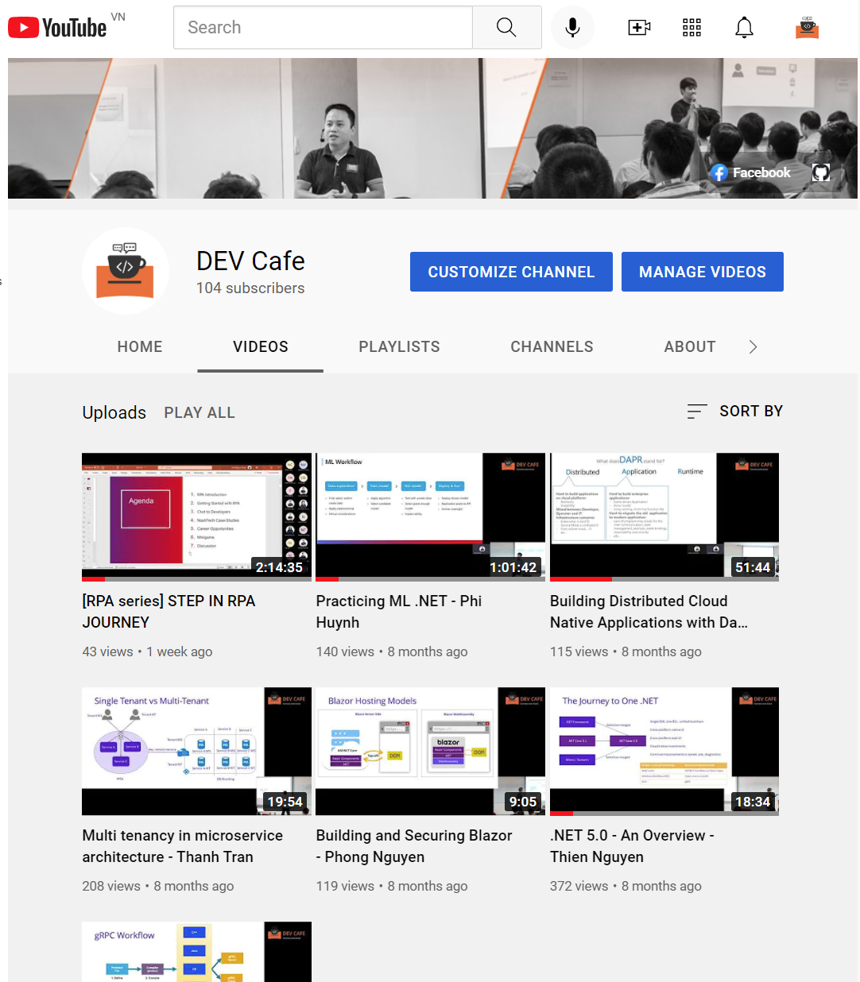
About DEV Cafe
https://www.facebook.com/devcafevn
https://www.youtube.com/c/devcafevn

Slide 3


.NET 6 – An Overview
Thien Nguyen

Slide 4
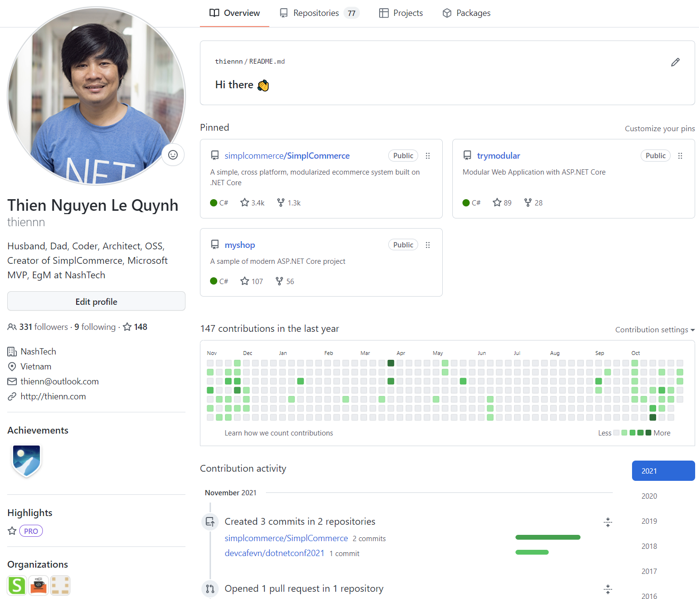
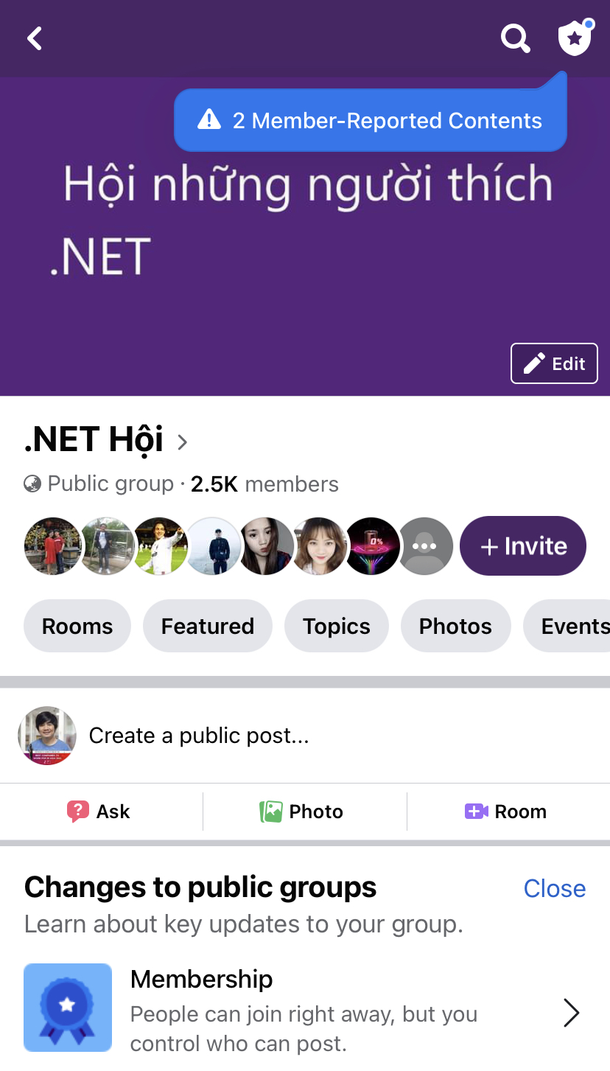
About me
https://www.facebook.com/groups/dotnetvn
https://github.com/thiennn

Slide 5
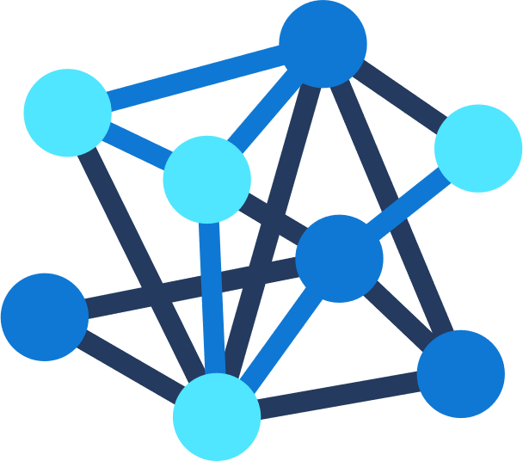







.NET – A unified development platform
ECOSYSTEM
TOOLS
CLOUD
WEB
MOBILE
GAMING
IoT
AI
NuGet
Visual Studio
DESKTOP
Azure
ASP.NET
Blazor
.NET MAUI
WPF
WinForms
.NET MAUI
Xamarin
Unity
ARM32
ARM64
ML.NET
.NET for Apache Spark
GitHub
Visual Studio for Mac
.NET 6
COMMON BASE LIBARIES/APIs
Components, tools, library vendors
Visual Studio Code
INFRASTRUCTURE
RUNTIME COMPONENTS
COMPILERS
LANGUAGES
CLI
Notes:
Cross-platform and open source, .NET is a unified development platform for building anything. You can use the same tools, libraries, languages and runtime to build any application across web, mobile, desktop, AI/ML, data, gaming, and IoT workloads. .NET is a general-purpose programming platform that enables all kinds of application scenarios. Once you learn one, you can easily pick up another. To enable specific app scenarios, app models (or app frameworks) are built on top of the base libraries and runtime to extend what .NET can do. With .NET 6, we’ve unified the SDK, common base libraries, and runtime on which all of these app models sit.
.NET has a vast ecosystem of thousands of library packages you get via NuGet and open-source projects in development on GitHub. There are also hundreds of vendors providing additional components, tools, libraries and services. You can use a broad set of IDEs and editors with .NET including best-in-class tools with Visual Studio, Visual Studio for Mac and the cross-platform editor Visual Studio Code.
Unified common base libraries & SDK
Industry leading performance
C# 10
Apple Silicon (Arm64) support
Long-Term Support Release
.NET Upgrade Asssistant

Slide 6




.NET Multi-platform App UI
.NET 6
Cross-platform, native UI
Single project system, single codebase
Deploy to multiple devices, mobile & desktop
General availability early next year
.NET MAUI
WinUI
Mac Catalyst
iOS
Android
macOS
iOS
github.com/dotnet/maui
Notes:
Next I want to talk about .NET MAUI.
.NET MAUI is the evolution of Xamarin.Forms designed to help you deliver high-performance, cross-platform, native desktop & mobile apps all from a single codebase.
.NET MAUI under the hood uses technologies out there today for building native apps on Windows with WinUI, Mac Catalyst for macOS, and of course, iOS and Android. .NET MAUI abstracts all those frameworks into a single framework built on .NET 6.
.NET MAUI on Windows supports WinUI allowing these apps to use all the newest native features on supported versions of Windows 10.
That means you can build all these apps for any device from a single codebase and project system. Instead of learning different stacks and languages for each, you can use one language, one set of libraries, and one UI stack for all of them.
It will release early spring next year. You can watch the progress and help contribute on GitHub in the /dotnet/maui repo.

Slide 7

Entity Framework Core 6.0
EF Core 6.0 70% faster than 5.0 on the industry-standard TechEmpower Fortunes benchmark
Heap allocations have been reduced by 43%.
Announcing Entity Framework Core 6.0 Preview 4: Performance Edition (microsoft.com)

Slide 8

Getting started
Global using and implicit using
File scoped namespace
Minimal APIs

Slide 9
ASP.NET Core 6
WebApplication
WebApplicationBuilder
Implements multiple different interfaces:
IHost - used to start and stop the host
IApplicationBuilder - used to build the middleware pipeline
IEndpointRouteBuilder - used to add endpoints
Adding Configuration using builder.Configuration.
Adding Services using builder.Services
Configure Logging using builder.Logging
General IHostBuilder and IWebHostBuilder configuration
https://andrewlock.net/exploring-dotnet-6-part-2-comparing-webapplicationbuilder-to-the-generic-host/

Slide 10

Hot reload everywhere
Available in CLI & Visual Studio 2022
All project types, all .NET versions 4.6+
Best with .NET 6
Notes:
https://github.com/dotnet/sdk/pull/22262

Slide 11

Demo hot reload
- Web app
- SimplCommerce

Slide 12

Other liked features
DateOnly and TimeOnly
Extended property pattern matching
ArgumentNullException.ThrowIfNull

Slide 13

Upgrading to ASP.NET Core 6
https://docs.microsoft.com/en-us/aspnet/core/migration/50-to-60
https://github.com/simplcommerce/SimplCommerce/commits/master

Slide 14


Thanks for joining !
https://www.facebook.com/devcafevn

Slide 15








Slide 16








Slide 17






Slide 18








Slide 19





Slide 20


Slide 21


Slide 22


Slide 23


Slide 24


